Slide 1
Digestion and Absorption of Food Nutrients

Slide 2
Objectives
Identify the major organs and accessory organs of the digestive system
Describe the major functions of the digestive system
Name the 4 main hormones that regulate digestion
Locate the sites of primary nutrient absorption
Compare and contrast carbohydrate, protein, and lipid digestion and absorption

Slide 3
Digestive Process
Controlled by the autonomic nervous system
Digestion hydrolyzes complex molecules into simpler substances for absorption
Self-regulating processes within the digestive tract largely control the
liquidity, mixing, and transit time of the digestive mixture

Slide 4
Hormones Control Digestion
Four hormones help to regulate digestion:
Gastrin
Secretin
Cholecystokinin CCK
Gastric inhibitory peptide

Slide 5
The Digestive System
Includes the esophagus, gallbladder, liver, stomach, pancreas, small intestine, large intestine, rectum, and anus
Surrounded by a connective tissue mesentery that weaves around and supports the intestinal organs
Contains a diffuse network of capillaries that transports absorbed nutrients via the hepatic-portal vein to the liver
The liver processes the nutrients

Slide 6
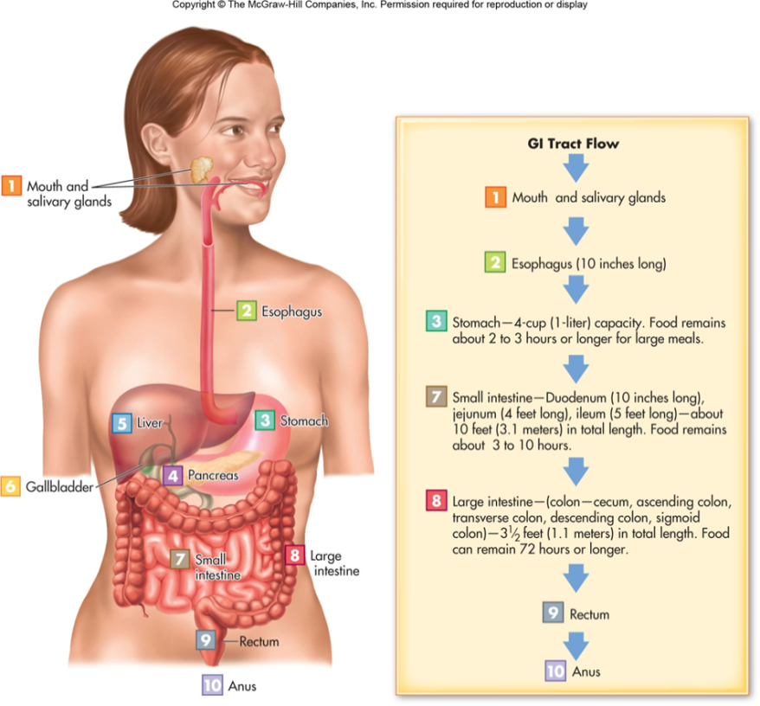
The Digestive System
GI tract
Mouth, esophagus, stomach, small intestine, large intestine
Liver, pancreas, and gall bladder

Slide 7
Functions of The Digestive System
Digestion
Process of breaking down foods into a form the body can use
Absorption
Uptake of nutrients from the GI tract into the blood or lymph
Excretion of waste matter
Immune system function

Slide 8
The Mouth and Esophagus
Mouth
Chewing or mechanical digestion alters food in the mouth
Easier to swallow
Increases the accessibility to enzymes
Esophagus
Connects the pharynx to the stomach

Slide 9
Peristalsis and Sphincters
Peristalsis involves progressive, recurring waves of smooth muscle contractions that compress and squeeze the Gi tract
Sphincters control the passage of food
Act as valves the regulate passage or flow of material through the GI tract
Respond to stimuli from nerves, hormones, and hormonelike substances and an increase in pressure
Notes:
Occurs throughout the alimentary tube including the esophagus and intestines.
Sphincters in the GI tract include esophageal (upper and lower), pyloric, oddi, ileocecal, and anal (2).

Slide 10
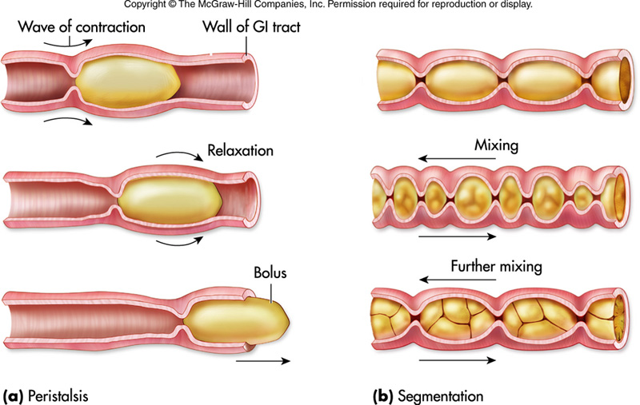

Slide 11
The Stomach
Temporary holding tank for partially digested food before moving it into the small intestine
The stomach’s contents mix with chemicals substances to produce chime, a mixture of food and digestive juices
Parietal cells secrete HCI stimulated by gastrin and acetylcholine released by the vagus nerve
Good mixes as HCI and enzymes continue the breakdown process
Notes:
The stomach usually takes 1 to 4 hours to empty.
The stomach may retain a high-fat meal for up to 6 hours before its chyme empties into the small intestine.
With the exception of alcohol and aspirin, little absorption takes place in the stomach.

Slide 12
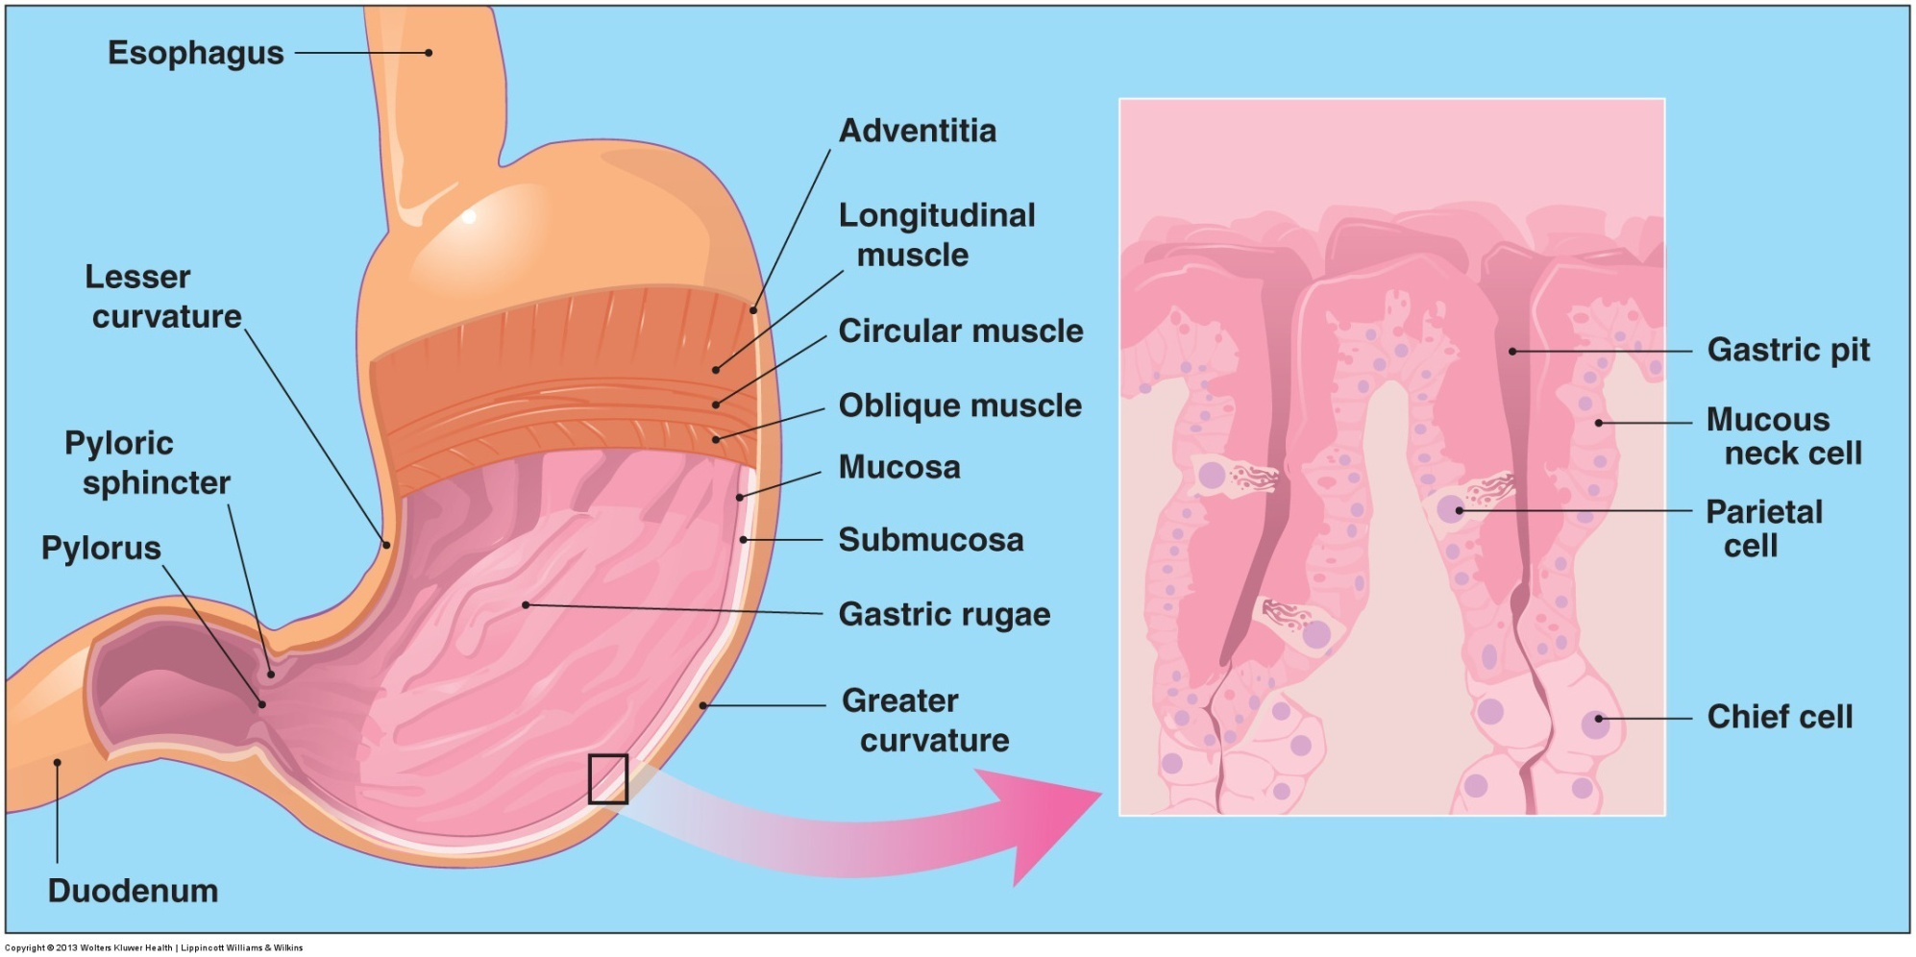

Slide 13
The Small Intestine
Consists of three sections: the duodenum, the jejunum, and the lieum
Most digestion and absorption occurs here
Absorption takes place through millions of villi
Most absorption through the villi occurs by active transport that uses a carrier molecule and expends ATP energy
Notes:
Villi increase the absorptive surface of the intestine by up to 600-fold compared with a flat-surfaced tube of the same dimensions.
Microvilli contain the digestive enzymes and absorb the smaller digested units of carbohydrates, proteins, and lipids, in addition to water, electrolytes, alcohol, vitamins, and minerals

Slide 14
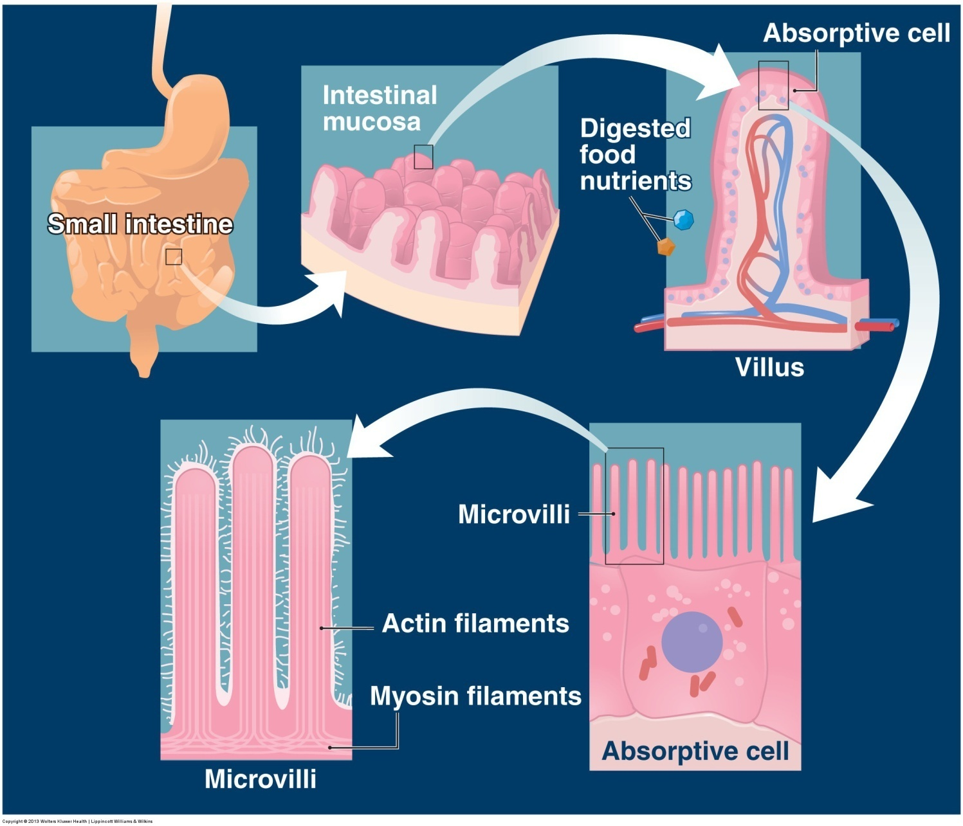

Slide 15
Intestinal Contractions
1–3 days for foods to leave the GI tract
Segmentation: intermittent contractions and relaxations of the intestinal wall’s circular smooth muscle
Gives digestive juices time to mix with food
Gallbladder and pancreas secrete digestive juices
Notes:
Segmentation augments mechanical mixing of intestinal chyme with bile, pancreatic juice, and intestinal juice.
Bile is produced by the liver but is stored and released by the gallbladder to allow for fat digestion.
Pancreas secretes alkali juice to neutralize hydrochloric acid and also secretes enzymes.

Slide 16
The Large Intestine
This terminal portion of the GI tract contains no villi
Major anatomic sections include the ascending colon, transverse colon, descending colon, sigmoid colon, rectum, and anal canal
Bacterial ferment the remaining undigested food residue
Serves as a storage area for undigested food residue feces
Where absorption of water and electrolytes occurs
Notes:
Intestinal bacteria synthesize small amounts of vitamins K and biotin, which then become absorbed.

Slide 17
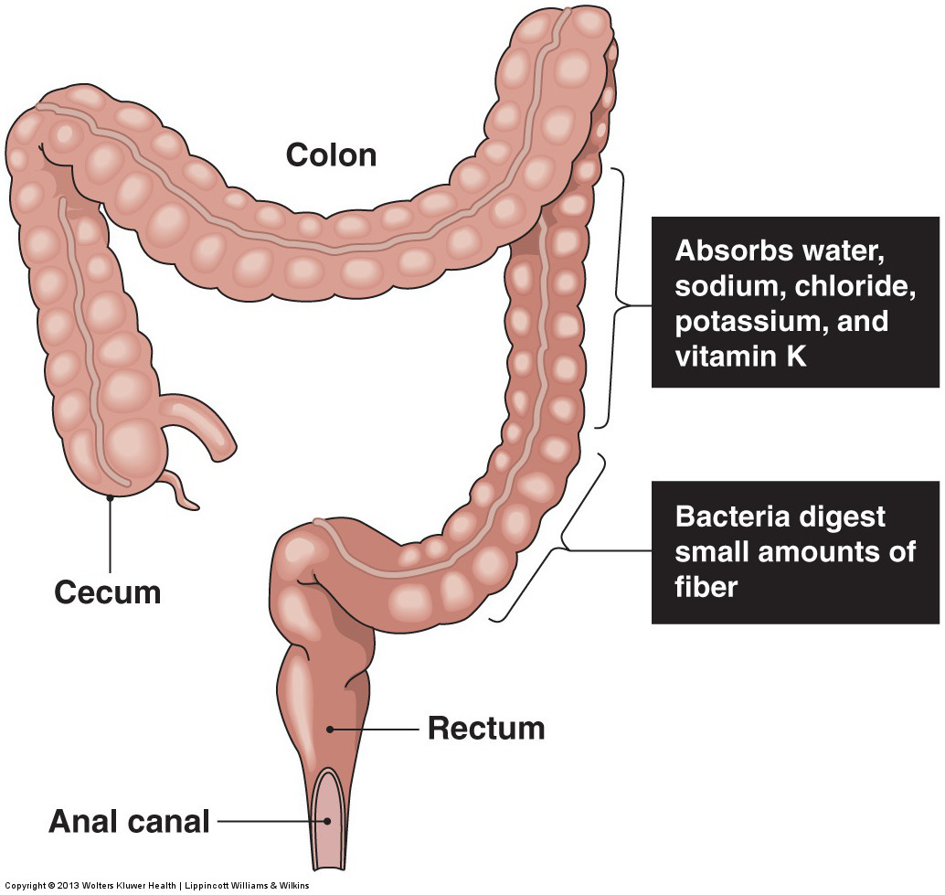

Slide 18
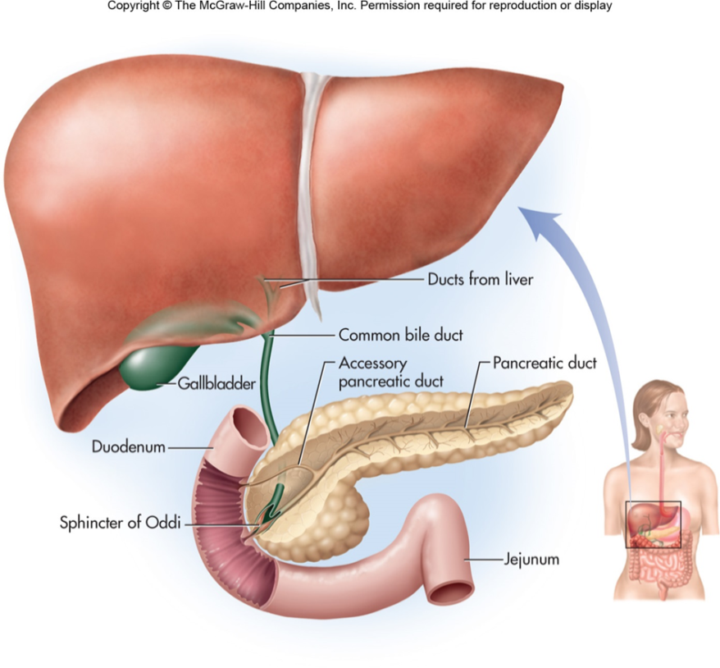
Liver, Gallbladder and Pancreas
Liver
Provides bile
Enterohepatic circulation recycling of bile
Gallbladder
Bile storage
Pancreas
Produces sodium bicarbonate, lipases, proteases and pancreatic amylase

Slide 19
Absorption of Nutrients
Primarily occurs in the small intestine
Passive diffusion
Concentration gradient
Facilitated diffusion
Concentration gradient + carrier protein
Active
Carrie protein + energy regardless of concentration
Endocytosis
Engulfment of compounds or liquids

Slide 20
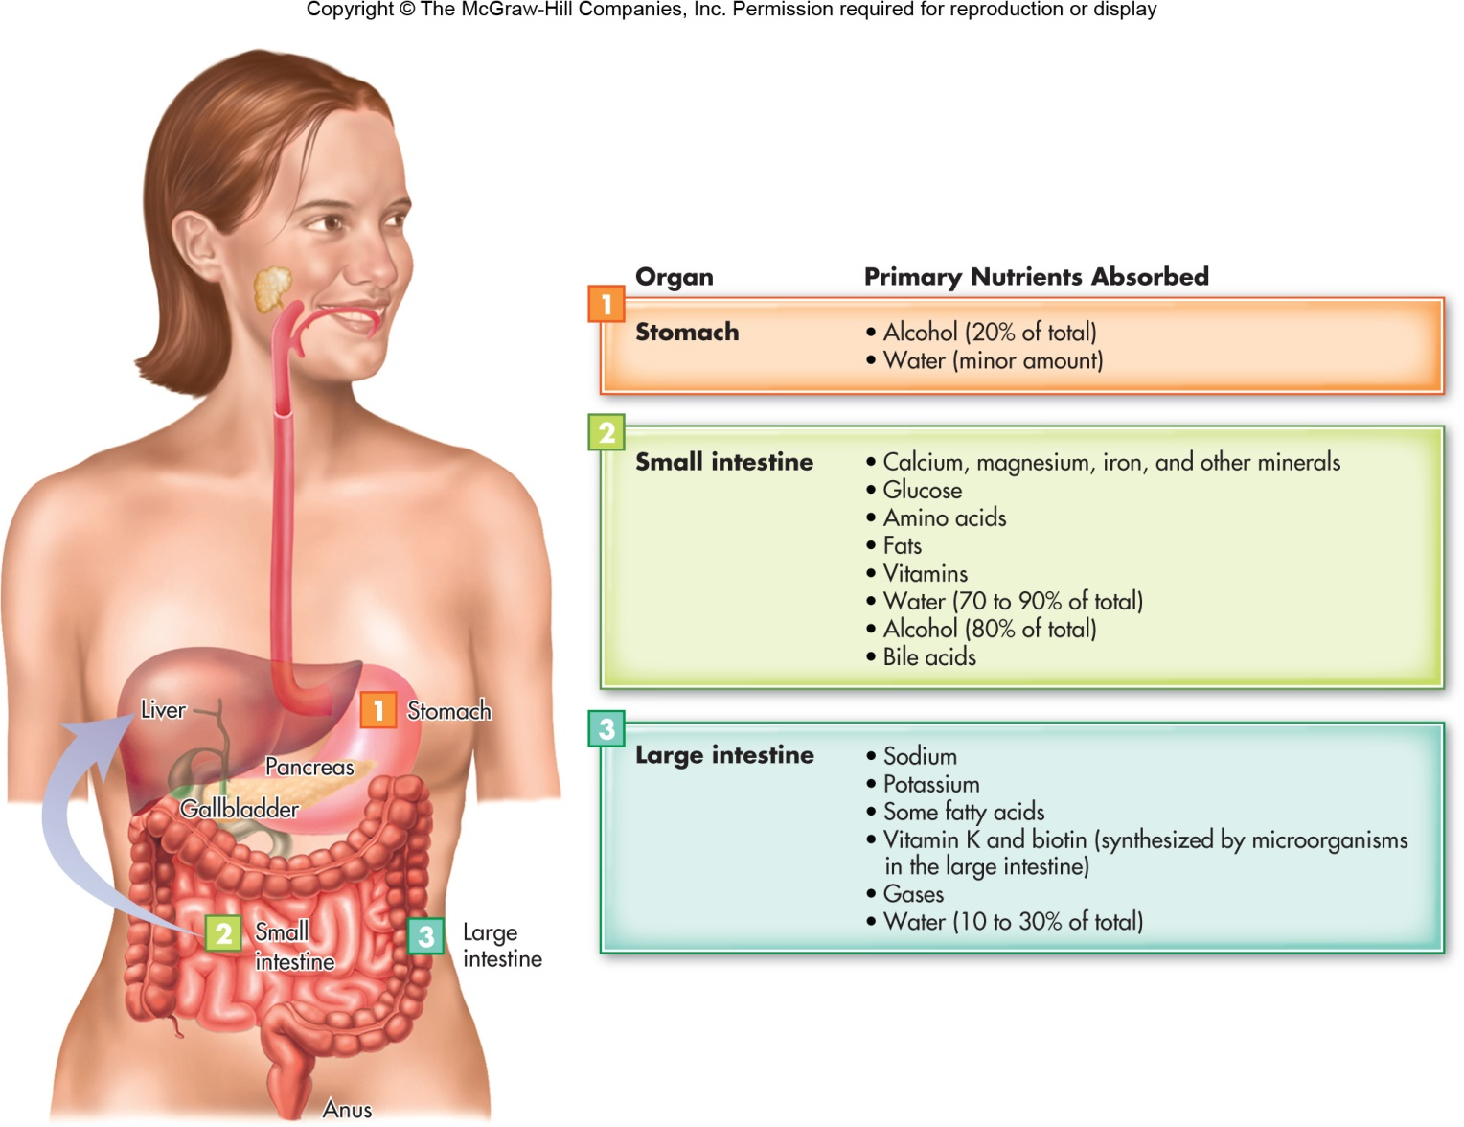

Slide 21
Carbohydrate Digestion and Absorption
Salivary amylase degrades starch to simpler disaccharides
Pancreatic amylase continues carbohydrate hydrolysis
Enzymes on the brush border complete the final stage of carbohydrate digestion to monosaccharides
MALTASE
SUCRASE
LACTASE
Notes:
The salivary glands, located along the underside of the jaw, continually secrete lubricating mucous substances that combine with food particles during chewing.
Maltase breaks down maltose to its glucose components.
Sucrase reduces sucrose to the simple sugars glucose and fructose.
Lactase degrades lactose to glucose and galactose.

Slide 22
Lipid Digestion and Absorption
Lingual lipase begins lipid digestion in the mouth
Short-chain and medium-chain saturated fatty acids
Gastric lipase continues lipid breakdown in the stomach
Majority of lipid breakdown occurs in the small intestine
Notes:
Lingual lipase continues to work in the stomach.

Slide 23
Lipids Digestion and Absorption
Major lipid breakdown occurs by the emulsifying action of bile and the hydrolytic action of pancreatic lipase
Cholecystokinin CCK is released from the wall of the duodenum
Gastric inhibitory peptide and secretin are released in response to a high lipid content in the stomach
Notes:
Bile increases the lipid droplets’ solubility and digestibility through emulsification.
CCK regulates GI functions including stomach motility and secretion, gallbladder contraction and bile flow, and enzyme secretion by the pancreas.
Gastric inhibitory peptide reduces gastric motility.

Slide 24
Medium-Chain Triacylglycerols
Medium-chain triacylglycerols rapidly absorb into the portal vein
Bound to glycerol and medium-chain free fatty acids
Bypass the lymphatic system and enter the bloodstream rapidly
Notes:
Medium-chain triacylglycerols are transported to the liver for subsequent use by various tissues in energy metabolism.

Slide 25
Long-Chain Fatty Acids
Long-chain fatty acids are absorbed by the intestinal mucosa, reform into chylomicrons
Chylomicrons move slowly through the lymphatic system and empty into venous blood of the systemic circulation
Lipoprotein lipase is an enzyme that allows chylomicrons to hydrolyze into free fatty acids and glycerol
Notes:
Enter systemic circulation in the neck region by way of the thoracic duct.

Slide 26
Protein Digestion and Absorption
Pepsin initiates protein digestion in the stomach
Gastrin stimulates secretion of gastric HCl, performing many functions
Activates pepsin
Stimulates the release of HCI
Improves absorption of iron and calcium
Denatures food proteins, making them more vulnerable to enzyme action

Slide 27
Protein Digestion and Absorption
The final steps in protein digestion occur under the action of the enzyme trypsin
The peptide fragments further into tripeptides, dipeptides, and single amino acids
Amino acids also join with sodium for active absorption through the small intestine into the portal vein and on to the liver
Notes:
Trypsinogen is the inactive precursor form of trypsin.

Slide 28
Amino Acids in the Liver
Once amino acids reach the liver, one of three events occurs:
conversion to glucose (glucogenic amino acids)
Conversion to fat(ketogenic amino acids)
direct release into the bloodstream as plasma proteins, such as albumin, or as free amino acids
Notes:
Free amino acids are synthesized into biologically important proteins, peptides (e.g., hormones), and amino acid derivatives such as phosphocreatine and choline, the essential component of the neurotransmitter acetylcholine.

Slide 29
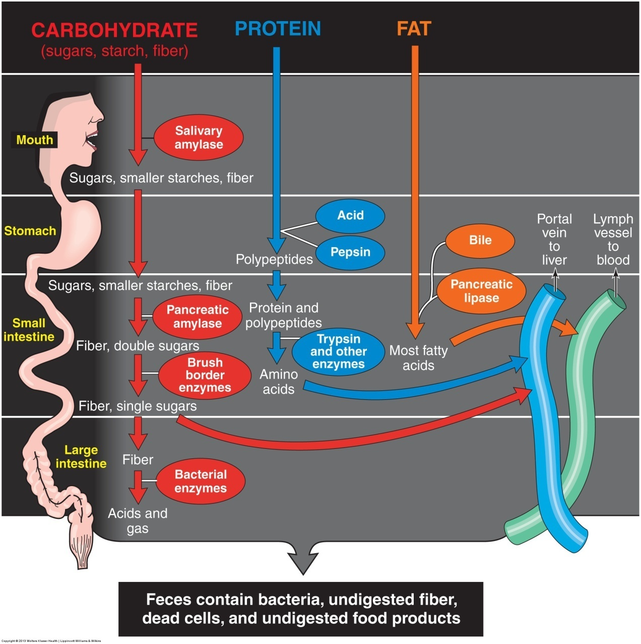

Slide 30
Vitamins
Vitamin absorption occurs mainly by the passive process of diffusion in the jejunum and ileum
Fat-soluble vitamins are absorbed with dietary lipids
Once absorbed, chylomicrons and lipoproteins transport these vitamins to the liver and fatty tissues

Slide 31
Vitamins
Water-soluble vitamins diffuse into the blood, except for vitamins B12
This vitamin combines with intrinsic factor produced by the stomach
Water-soluble vitamins pass into the urine when their concentration in plasma exceeds the renal capacity for reabsorption

Slide 32
Minerals
Both extrinsic (dietary) and intrinsic (cellular) factors control the eventual fate of ingested minerals
The body does not absorb minerals very well
Mineral availability in the body depends on the chemical form
Notes:
Example: Males absorb calcium better than females, yet total calcium absorption rarely exceeds 35% of the amount ingested.

Slide 33
Water Absorption
Major absorption of ingested water and water contained in foods occurs by the passive process of osmosis in the small intestine
Intestinal tract absorbs about 9 L of water each day
72% absorbed in the proximal small intestine
20% absorbed from the distal segment of the small intestine
8% absorbed from the large intestine
Notes:
7 liters: saliva, gastric secretions, bile, and pancreatic and intestinal secretions, 2 liters ingested water

